Slide 1
TaskBomber
A Yellow Submarine Product

Slide 2
Help Basic Edit
Adding of tasks
Add Task Name |  |  |  | Add a floating task |  | Add groceries
Add Task Name by Date |  |  |  | Add a deadline task |  | Add groceries by 7pm
Add Task Name from start to end |  |  |  | Add a task with a specific start and end time |  | Add groceries from 5pm to 7pm
Add Task Name #1 |  |  |  | Add a task of priority 1 |  | Add groceries #1
If TaskBomber mistaken your task name for a command etc, use “ “ E.g. Watch “tomorrow” The Movie
Deleting specific task
Delete index |  |  |  | Delete the task of the given index |  | Delete 1
Delete task keyword |  |  |  | Delete first task with the given keyword |  | Delete shopping
Editing of task detail
Edit `Task Name `# `new Detail |  | Change the priority of task |  |  |  | Edit `groceries `# `#2
Edit `Task Name `name `new Detail |  | Change the name of task |  |  |  | Edit `groceries `name `buy fruits
Edit `Task Name `date `new Detail |  | Change date of task (startTime or endTime) |  |  |  | Edit `groceries `startTime `10 oct
Search
Search type | Search the task with matching task names, priorities or date |  |  |  | Search errands Search #2 Search 30/Oct Search #2 errands Search 30/Oct #2 errands
Sort
Sort type |  |  | Sorts the given type alphabetically or numerically |  |  | Sort Name Sort # Sort time
Undo/Redo changes
Undo |  |  |  | Undo your last typed input |  | Undo
Redo |  |  |  | Redo any previous undo |  | Redo
Type “SOS” to find out the basic command

Slide 3
Help
Type The following commands to find out more!
SOS | Quick start for TaskBomber
Shortcuts ( `sc ) | Shortcut for faster typing
Help Basic ( `hb ) | Full cheat sheet
Help Advance ( `ha ) | Advance guide
Credit ( `cd ) | The sailors behind this project

Slide 4


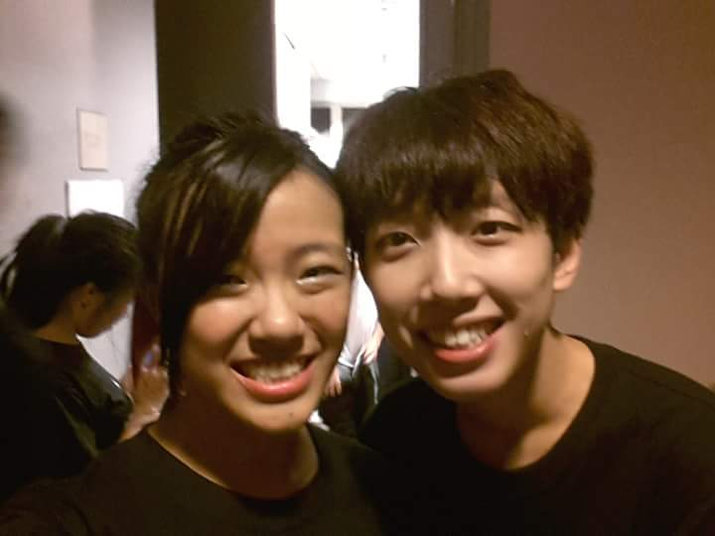

The Sailors
Da Xuan
Logic
…
Su Mei
Captain
User Interface
Undo/Redo
…
Bai Chuan
Storage
…
Adrian
Special
Feature
Design
…

Slide 5
S.O.S.
Add a task ( `a )
Add Task Name | Add Meeting
Delete the task of the given index ( `d )
Delete index | Delete 1
Edit a detail of specific task ( `e )
Edit `Task Name `Type `New Details | Edit `meeting `# `#2
Made a Mistake?
Undo | Redo
Find out more by typing “Help All” or “`ha” to find out more!
Sort task to specified type (`st)
Sort type | Sort Name Sort # Sort date
Display matching task name, priority or day ( `f )
Find type | Find errands Find #2 Find 30 Oct

Slide 6
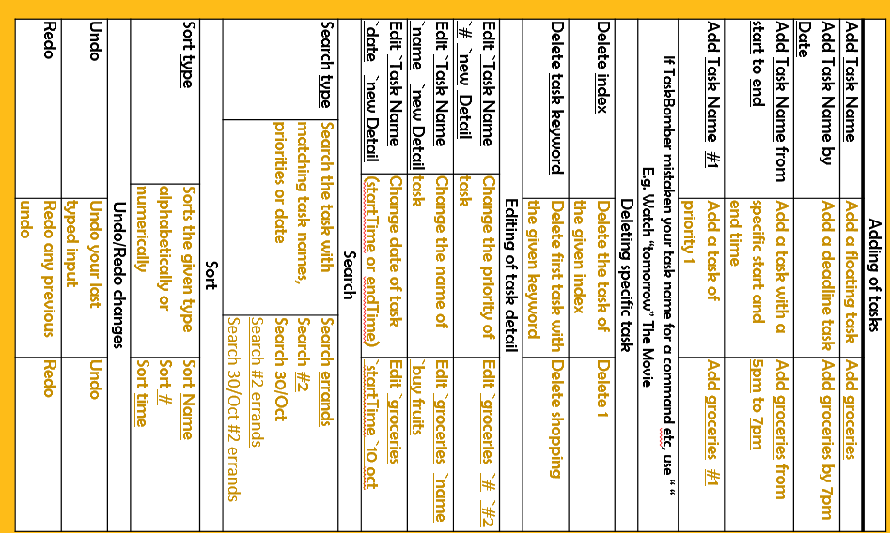
Help Basic
Adding of tasks
Add Task Name |  |  |  | Add a floating task |  | Add groceries
Add Task Name by Date |  |  |  | Add a deadline task |  | Add groceries by 7pm
Add Task Name from start to end |  |  |  | Add a task with a specific start and end time |  | Add groceries from 5pm to 7pm
Add Task Name #1 |  |  |  | Add a task of priority 1 |  | Add groceries #1
If TaskBomber mistaken your task name for a command etc, use “ “ E.g. Watch “tomorrow” The Movie
Deleting specific task
Delete index |  |  |  | Delete the task of the given index |  | Delete 1
Delete task keyword |  |  |  | Delete first task with the given keyword |  | Delete shopping
Editing of task detail
Edit `Task Name `# `new Detail |  | Change the priority of task |  |  |  | Edit `groceries `# `#2
Edit `Task Name `name `new Detail |  | Change the name of task |  |  |  | Edit `groceries `name `buy fruits
Edit `Task Name `date `new Detail |  | Change date of task (startTime or endTime) |  |  |  | Edit `groceries `startTime `10 oct
Search
Search type | Search the task with matching task names, priorities or date |  |  |  | Search errands Search #2 Search 30/Oct Search #2 errands Search 30/Oct #2 errands
Sort
Sort type |  |  | Sorts the given type alphabetically or numerically |  |  | Sort Name Sort # Sort time
Undo/Redo changes
Undo |  |  |  | Undo your last typed input |  | Undo
Redo |  |  |  | Redo any previous undo |  | Redo
Type “SOS” to see the quick guide

Slide 7
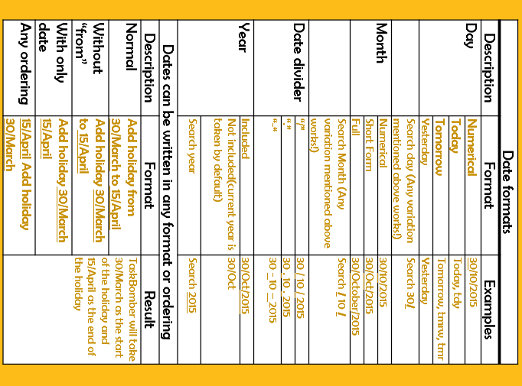
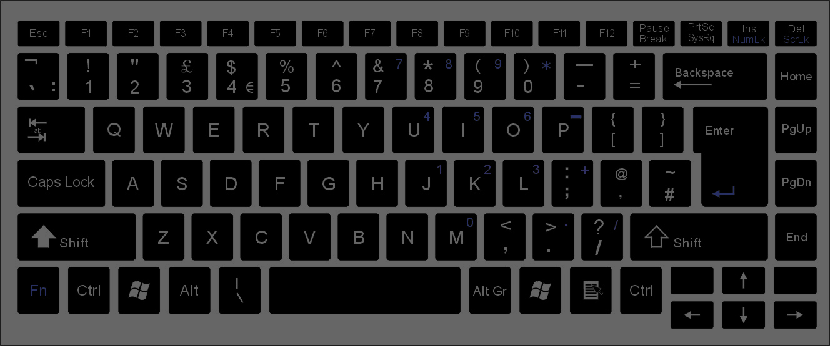
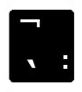
Help Advance
Where is the Back Tick button?
The additional things you need to know
Date formats
Description | Format | Examples
Day | Numerical | 30/10/2015
 | Today | Today, tdy
 | Tomorrow | Tomorrow, tmrw, tmr
 | Yesterday | Yesterday
 | Search day (Any variation mentioned above works!) | Search 30/
Month | Numerical | 30/10/2015
 | Short Form | 30/Oct/2015
 | Full | 30/October/2015
 | Search Month (Any variation mentioned above works!) | Search / 10 /
Date divider | “/” | 30 / 10 / 2015
 | “.” | 30 . 10 . 2015
 | “-“ | 30 - 10 – 2015
Year | Included | 30/Oct/2015
 | Not included(current year is taken by default) | 30/Oct
 | Search year | Search 2015
Dates can be written in any format or ordering
Description | Format | Result
Normal | Add holiday from 30/March to 15/April | TaskBomber will take 30/March as the start of the holiday and 15/April as the end of the holiday
Without “from” | Add holiday 30/March to 15/April
With only date | Add holiday 30/March 15/April
Any ordering | 15/April Add holiday 30/March

Slide 8
Shortcuts Edit
Description | Command Name | Shortcut
Add new task | Add | `a
 | Create | `c
 | New | `n
 | Plus | `p
Update or edit a task | Edit | `e
 | Update | `u
 | Change | `c
Delete a task | Delete | `del
 | Remove | `rmv
 | Bomb | `b
Search for a set of task | Search | `s
 | Find | `f
 | Read | `rd
 | Show | `s
Sort the task | Sort | ~st
Undo an input | Undo | ~un
Redo an input | Redo | ~re
Use the Backtick <`> button to access the shortcut

Slide 9
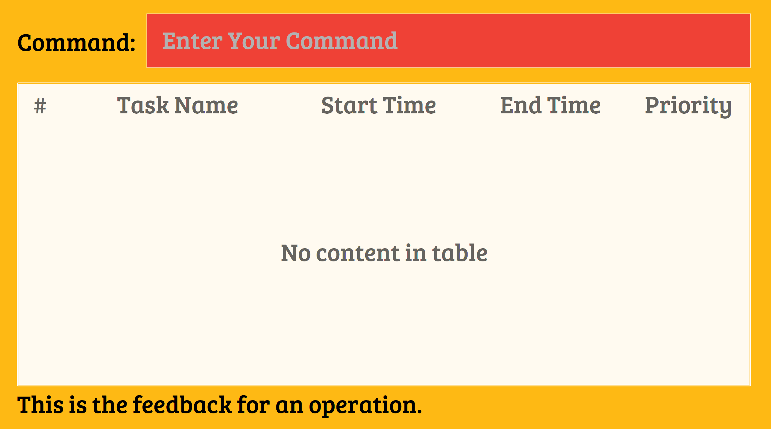
Overview
TaskBomber is a simple keyboard-driven to-do task manager.
You can manage your tasks easily by typing different commands into the
Command Bar

Slide 10
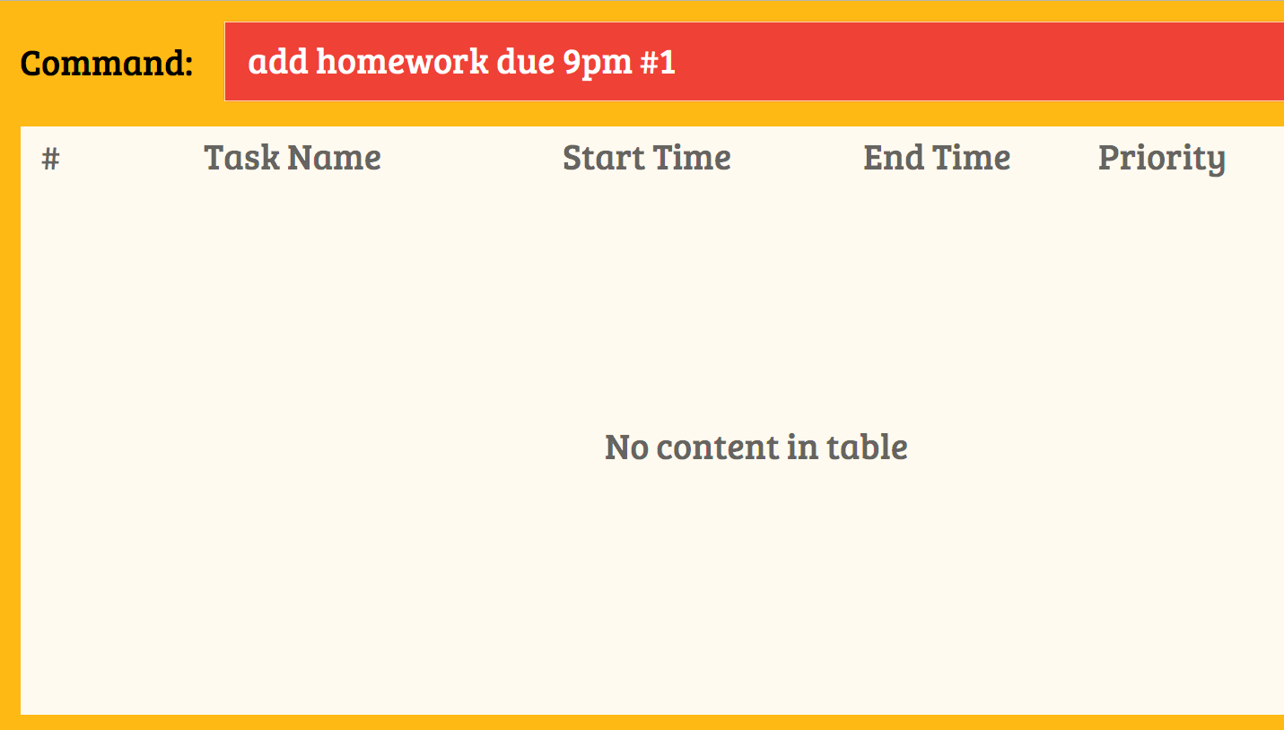
Add
Basic format:
eg:
add homework due 9pm #1
add [task name] [time] #[priority]

Slide 11
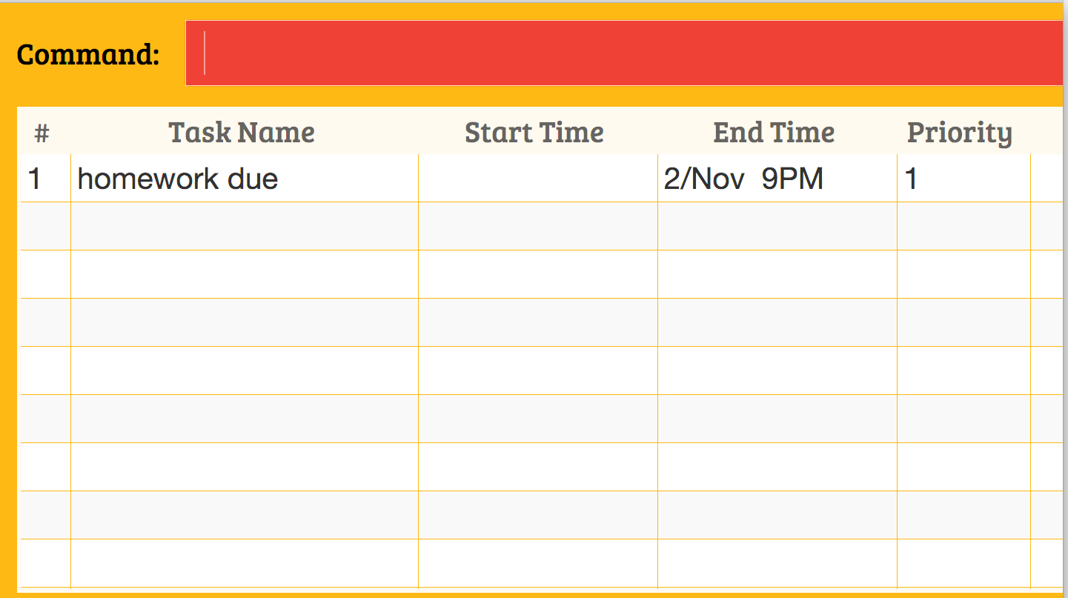
Add
Enter
Press

Slide 12
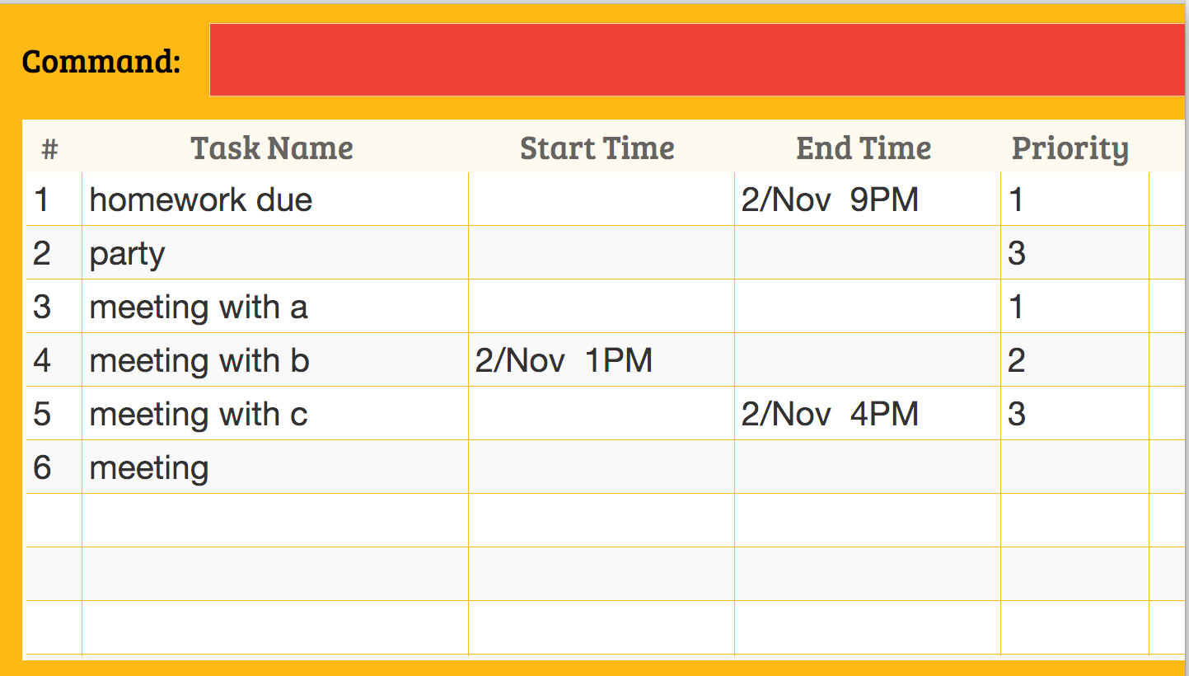
Delete
Basic format:
eg
delete meeting
delete [task name]

Slide 13
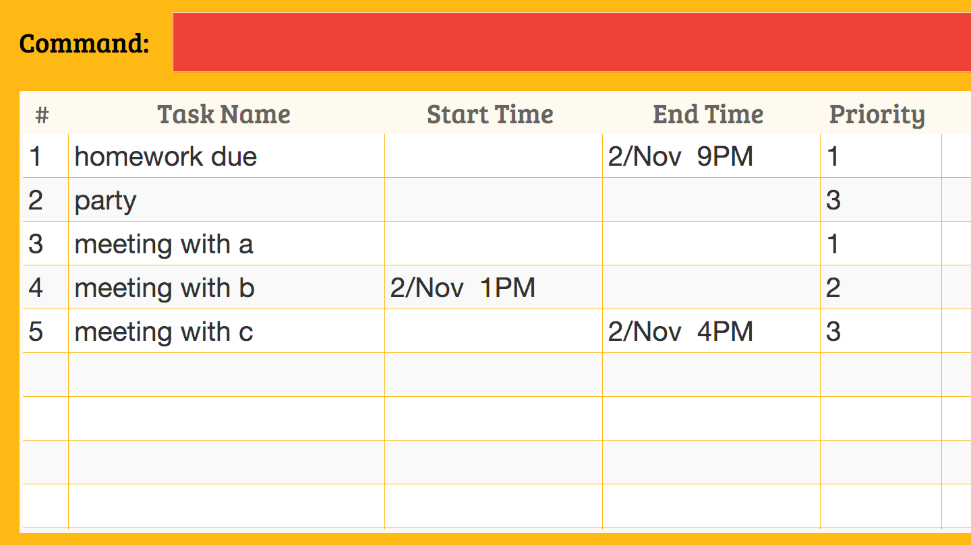
Delete
Basic format:
eg
delete meeting
delete [task name]

Slide 14

Delete
Basic format:
eg
delete 2
delete [index]

Slide 15
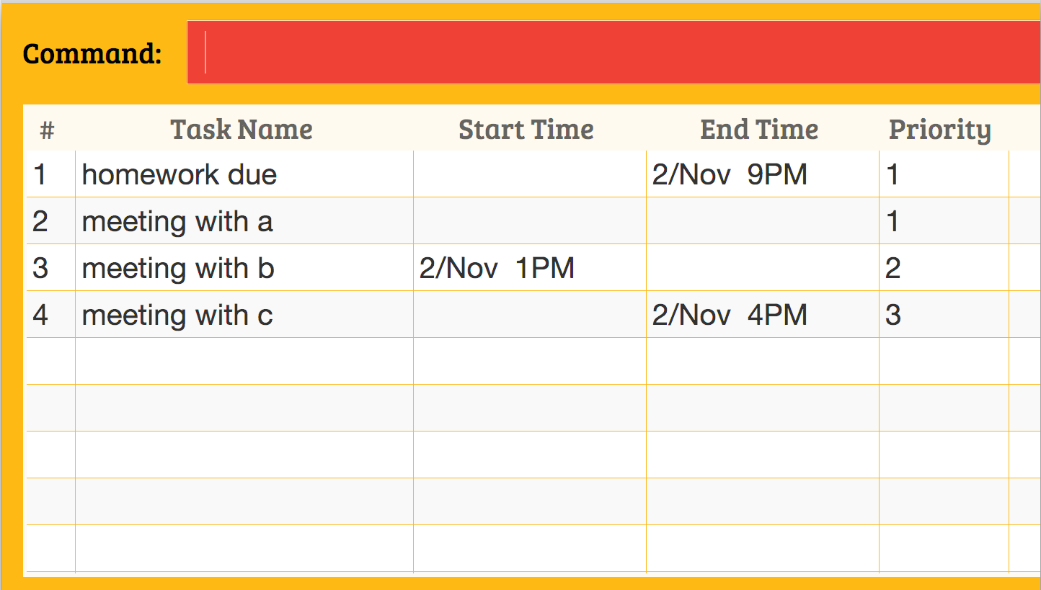
Delete
Basic format:
eg
delete 2
delete [index]

Slide 16
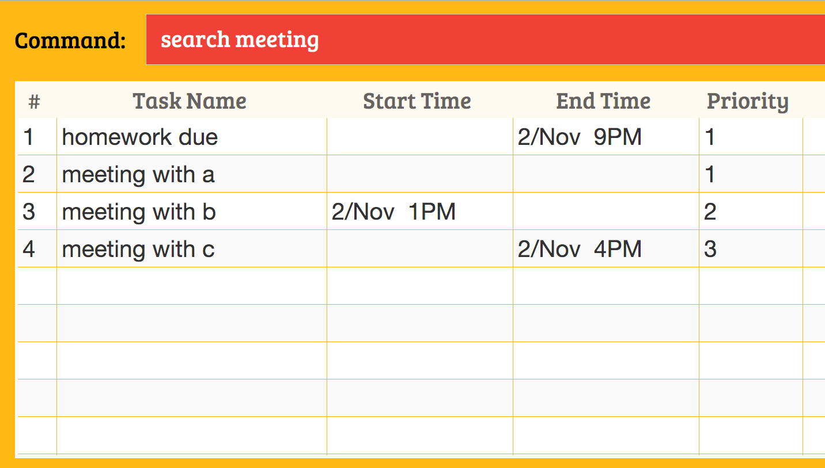
basic format: Search
Basic Format:
eg
search meeting
Search [keyword]

Slide 17
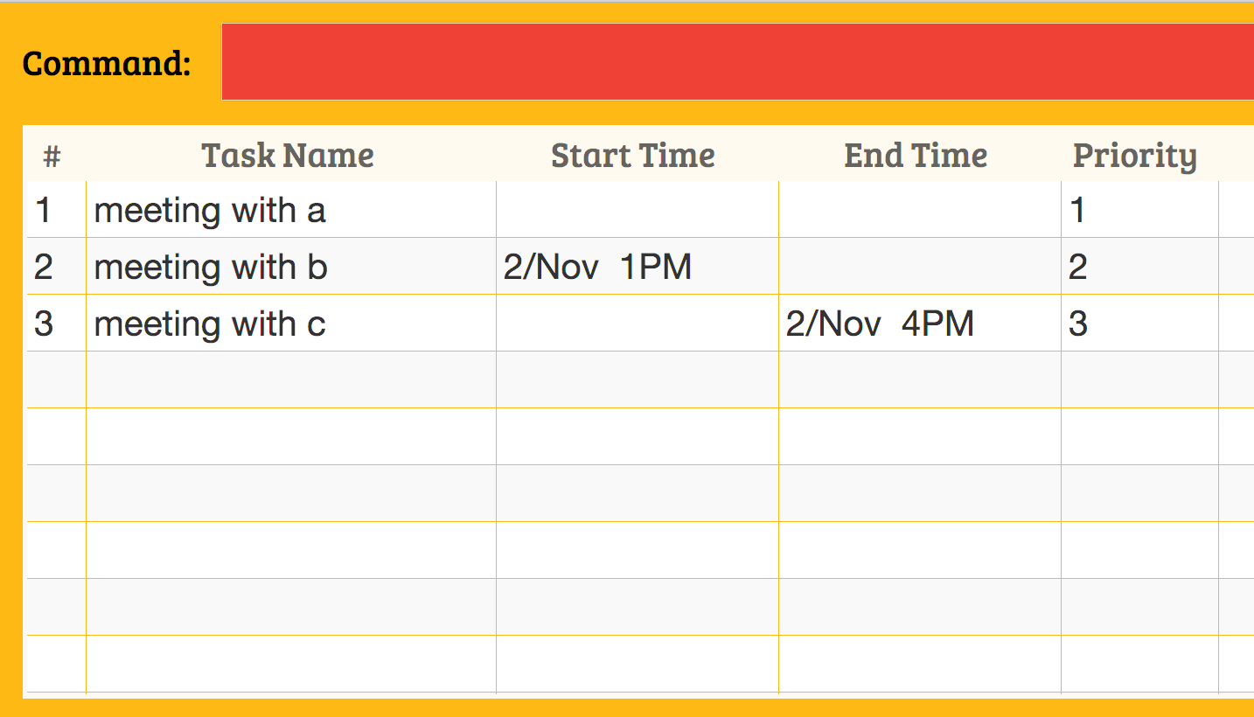
basic format: Search
Basic Format:
eg
search meeting
Search [keyword]

Slide 18
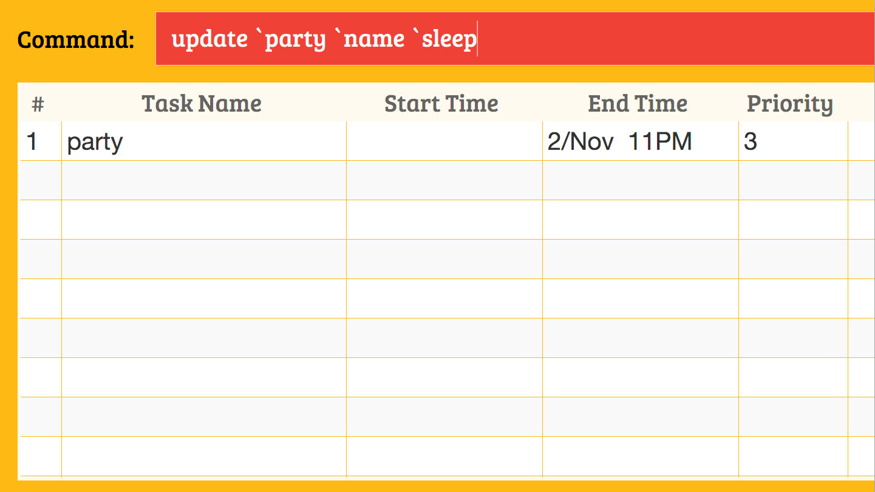
Update
Basic format:
eg
update `party `name `sleep
update `[target] `name `[new name]

Slide 19
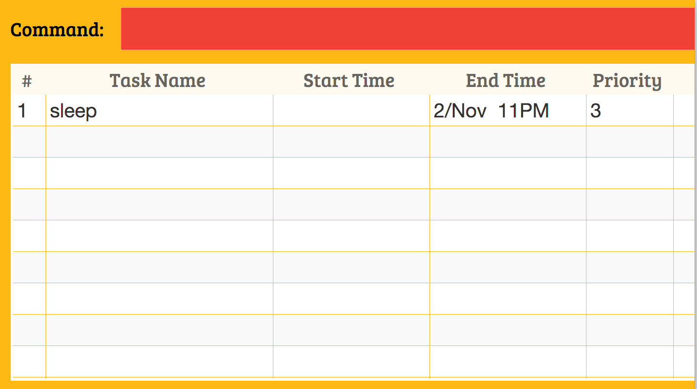
Update
Basic format:
eg
update `party `name `sleep
update `[target] `name `[new name]

Slide 20
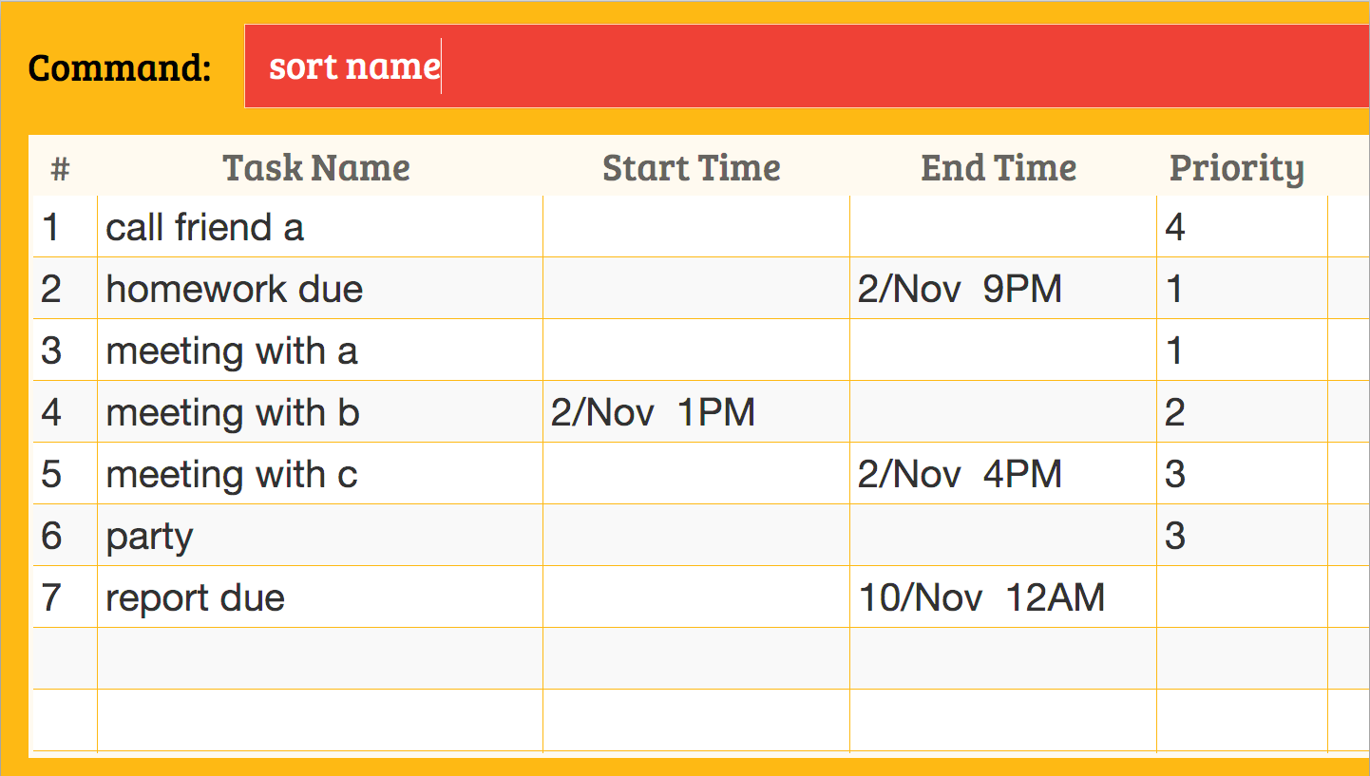
Sort
Command to type
Sort name

Slide 21
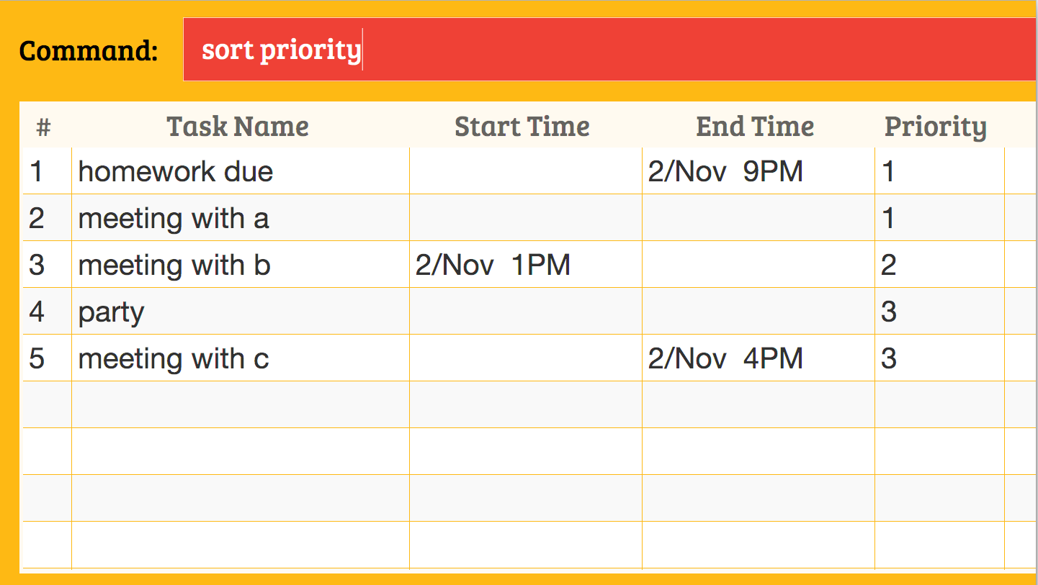
Sort
Command to type
Sort name
Sort priority

Slide 22
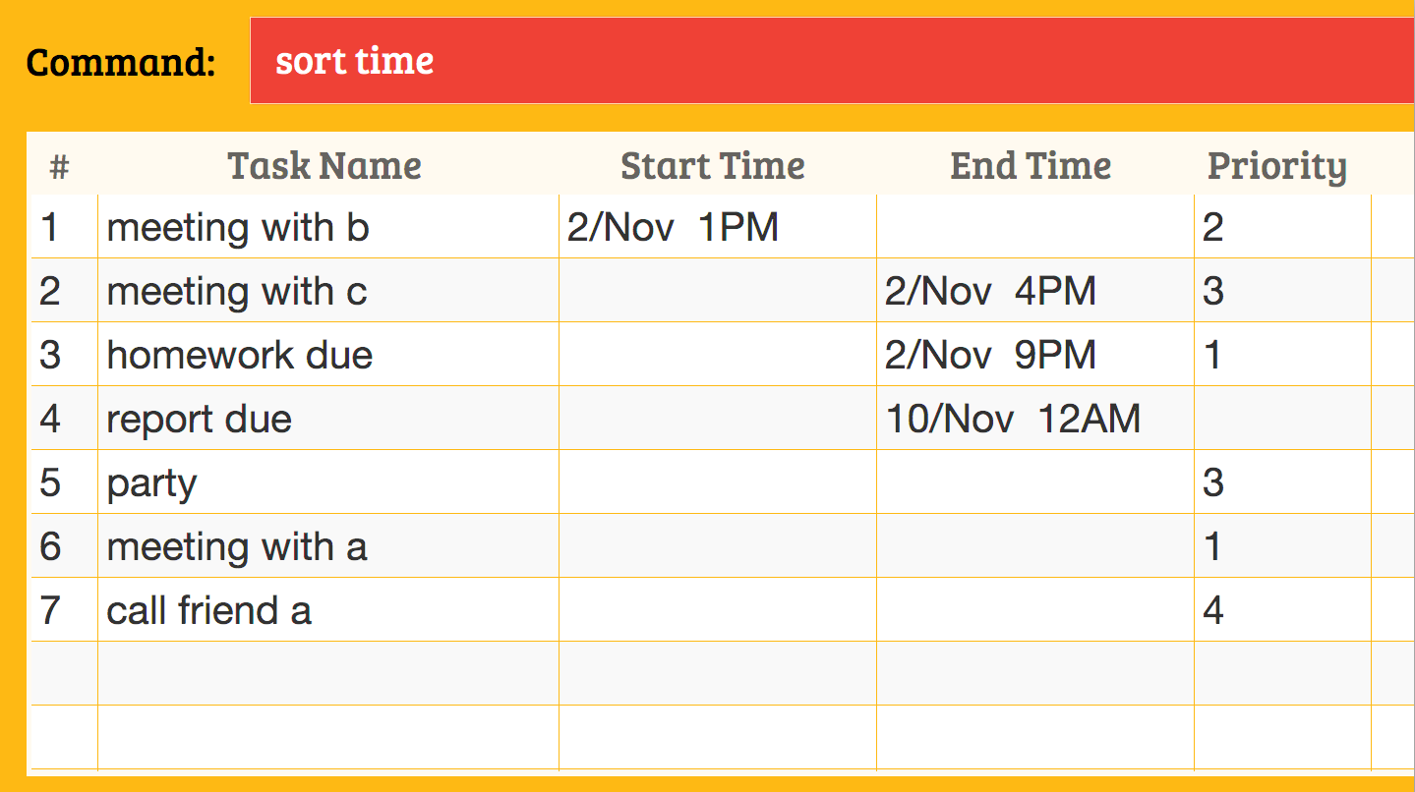
Sort
Command to type
Sort name
Sort priority
Sort time

Slide 23
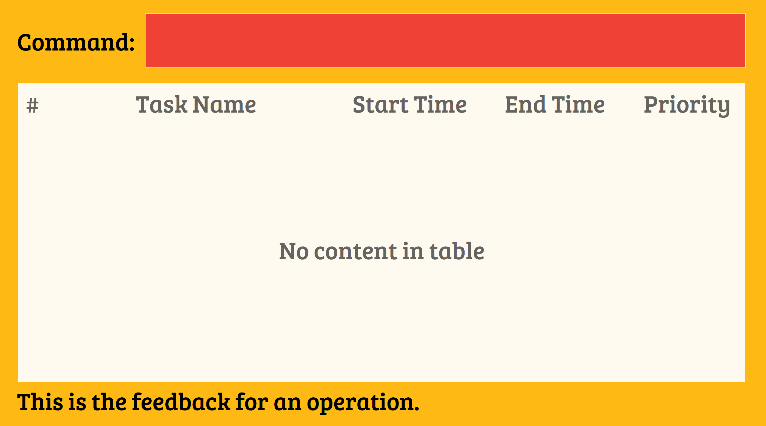
Clear
Command to type
clear

Slide 24
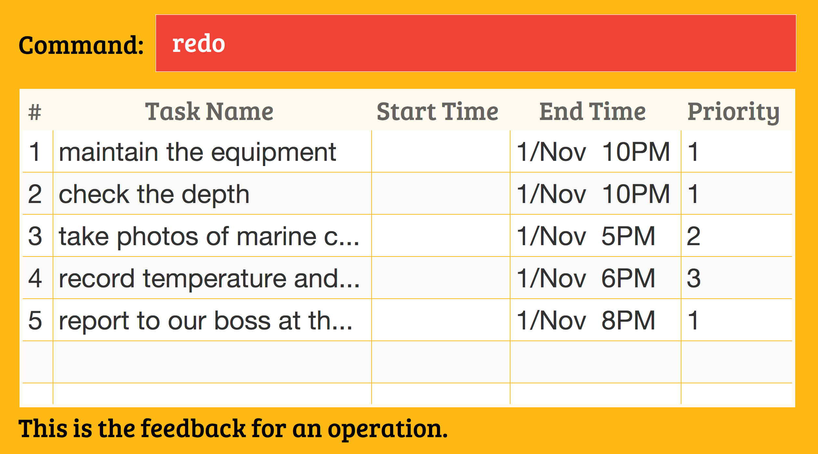
Undo
undo
Redo
redo

